Slide 1
SOMERSET PURPOSE
Somerset Academy, Inc. promotes a transformational culture that maximizes student achievement and the development of accountable, global learners in a safe and enriching environment that fosters high-quality education.
S - Set high expectations
O - Objective
M - Meaningful curriculum
E - Effective
R - Resourceful and responsible life long learners
S - Scholars who achieve proficiency and beyond
E - Evaluate continuously and use data to drive curriculum
T - Teachers who are highly qualified

Slide 2
DO NOT. . .
“Hang out” in the stairwells or on the second floor during lunch.
Chew gum. DO NOT BRING GUM!
Go on the basketball court with a skateboard!
Use the elevator without approval from the office.
Leave campus if you are a Middle Schooler, Freshman or Sophomore (Except for DE students)
Allow an underclassmen in your vehicle without prior permission, or you will lose all privileges for the remainder of the school year.
Throw anything off the balcony.
Throw anything from the ground level to the 2nd floor.
Eat or carry food over the basketball court or turf field
Litter or leave garbage around at lunch
Hang out by the wavy wall side or behind the basketball court bleachers
Hang on or grab the basketball nets/rims
Playing “keep away” = a detention
Yoga pants/ leggings/ are not allowed. Not even during dress down days. Dress code violations earn detentions
You are not to go to the Deans’ office during class to argue a detention. You will be turned away.

Slide 3
NO FOOD ON THE COURT

Slide 4
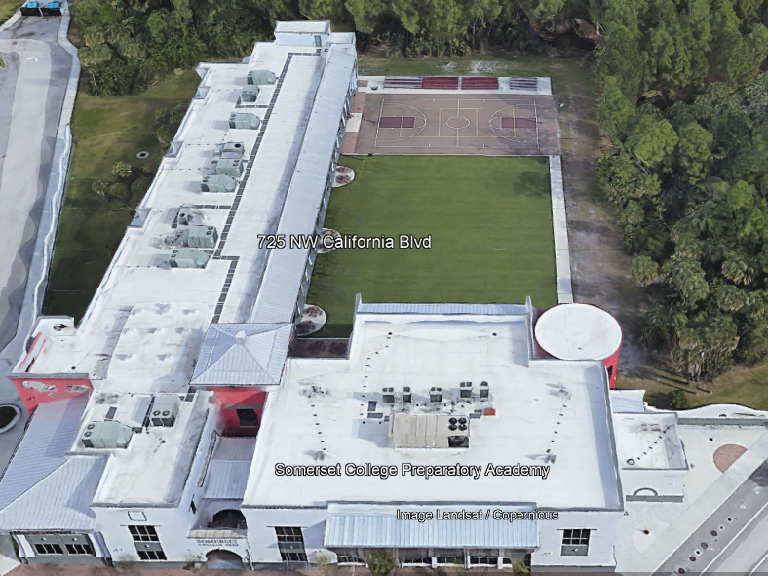
There is NO open food or liquid on the turf!!!
If you are caught, you will be having a meeting with the deans
TURF!

Slide 5
Tutoring Schedule
Mondays – ENGLISH (please see the schedule for which teach is staying for tutoring. The schedule is posted in all English teacher Classrooms)
Tuesdays – Math (ALL Math teachers)
Wednesdays – Social Studies
Thursdays – Science
Fridays – NONE
Need tutoring for electives? See your teacher to schedule.

Slide 7
Student Parking
-Permits from 2021 – 2022 School year are no longer valid.
-Any permit number up to 0309 is NOT valid
Applications for 2022-2023 are available in the main office.
Bring completed application, $20 cash or check and your documents to
Mrs. Ruiz at the Front Desk.

Slide 8
Attention Students
Do Not Spray any Body Sprays , Perfumes or Cologne's in the Restroom or Locker rooms. Anyone caught will receive a Detention

Slide 9
Dress Code Violations (Do Not Wear)
Non-Somerset Hoodies, Polos or Sweatshirts
Ripped or Frayed Jeans
Sweatpants, Joggers or Pajama Pants
Crocs or Slides

Slide 10
Discipline Matrix
Warning
A warning issued by 1st period teacher or Staff. Email sent home via Concierge.
Tuesday & Thursday inside the cafeteria. Attendance will be taken; 30 minutes to eat lunch and 20 minutes to clean up inside and outside of cafeteria
Monday Detention
Monday Detention afterschool. 3:50pm to 4:50pm
Lunch Detention
Saturday Detention
Referral & Behavior Probation
Saturday Detention
9:30am to 12:30pm
Referral and 9-week behavior probation contract.
1st Offense
2nd Offense
3rd Offense
4th Offense
5th Offense

Slide 11
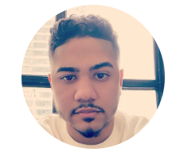

Slide 12
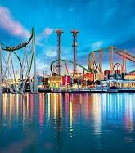
Gradventure Interest Meeting January 30 (8th grade only)
Trip on
May 12-13,2023
With Mr. Horne and Ms. DeCesare

Slide 13
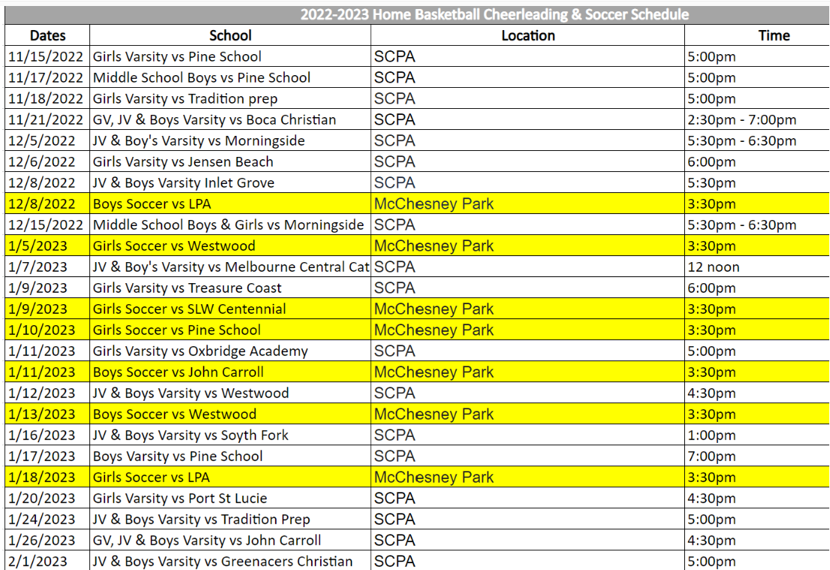

Slide 14
House Olympic Games
Houses | Points Earned | Totals
 | Soccer | Strength | Football | Volleyball | Basketball | Turf & Field
Athena | 75 | 95 | 50 |  | 50 | 25 | 295
Ares | 0 | 95 | 50 |  | 25 | 0 | 170
Hestia | 0 | 241 | 100 |  | 50 | 150 | 541
Poseidon | 75 | 114 | 25 |  | 75 | 100 | 389
Zeus | 75 | 198 | 0 |  | 50 | 0 | 323

Slide 16
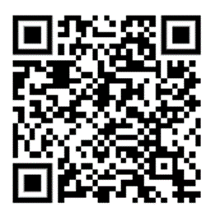
2023 Drama Production
The 2023 Drama Production will be Power Line by Don Zolidis.
Use the QR code to sign up for auditions.
Please read the instructions on the sign-up genius before selecting an audition slot.
If you have any questions, please talk to Mr. Sinski in Room 168 before school or at lunch.

Slide 18
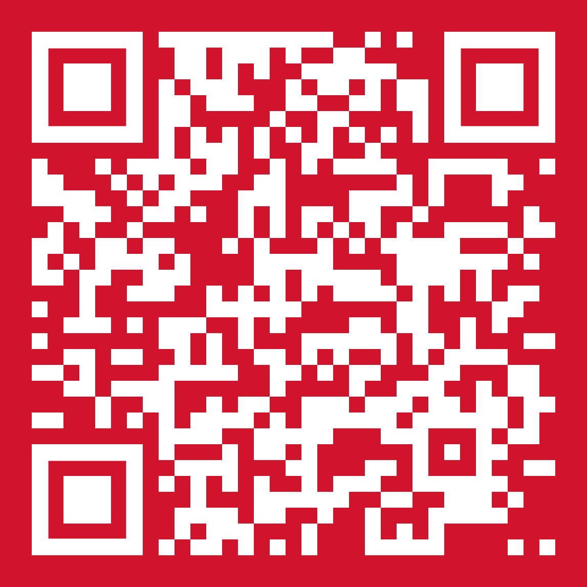
Attention Spartans
SGA is hosting a bus wash.
When:
Jan, 28
2023
Time:
9:00 am to
Finish
Where:
SCPA
Students who want to participate or need service hours, scan the QR code to sign up.

Slide 19
Create a Greeting Card Scholarship
Scholarship is open to all high school, college, and university students. The only eligibility criteria is that students must be at least 14 years or older at the time of entry (so some middle school students may even be able to apply). Home-schooled students are also welcome apply.
There is no required “theme,” but check out the Gallery website so that your card creation falls under one of the card lines featured.
The Gallery website states that while Christmas cards are their biggest sellers, birthday and anniversary cards are also popular. Have a penchant for sympathy or “get well” messages? Those themes are also welcome. Be sure to browse the Gallery website for ideas, but also remember that their cards are targeted to a corporate clientele.
The main criteria looked at:
Overall aesthetic appeal
Quality of execution
Creativity and Originality
Successful incorporation of design elements
Appropriateness for use as a greeting card

Slide 20
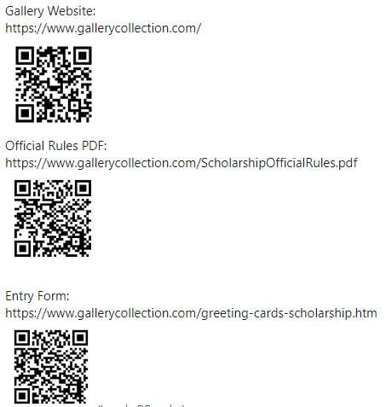
Create a Greeting Card Scholarship
The applicant with the winning entry will receive a cash scholarship of $10,000 plus a $1,000 prize for their school!
The winner’s award is paid directly to the school they will/are attending.
The Contest ends at 11:59:59 p.m. ET, March 02, 2023.

Slide 21
Stars and Stripes Theme Night
Dress up in your patriotic colors and come help support your basketball Spartans against Tradition Prep on Jan 24^{th!}
School appropriate clothing required!
This is not a dress down
Tickets:
$2 with student ID
$3 children
$5 Adult

Slide 22
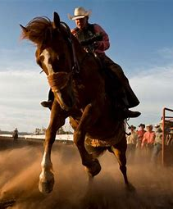
Cowboys And Cowgirls Theme Nights
Dress up for a rodeo and come support SCPA vs. John Carroll in their girl’s and boys’ basketball game on January 26, 2023.
School Appropriate Clothing is still Required! No Spurs!
Attire is only permitted for games, not for the school day!
Admission Prices
$2 with student ID
$3 children
$5 adult

Slide 23
Calling all artists!
FAU’s Harbor Branch is accepting Ocean Science Art from September 5th, 2022 to March 17th 2023, but they haven’t gotten a chance to update their website yet!
Please come see Mrs. Perez in 235 or email her at perez.lindsey@somersetcollegeprep.org
🏆K- 8th Grade Winner: “Harnessing the Power of Marine Sponges” by Trisha G., 7th grade
🏆High School Winner: “Coral” by Alex T., 12th grade
🏆 Adult Winner: “In Awe” by Linda S.
🏆People’s Choice Award Winner: “Tubed System” by Pjark S., 11th grade
More updates to come!!!

Slide 24
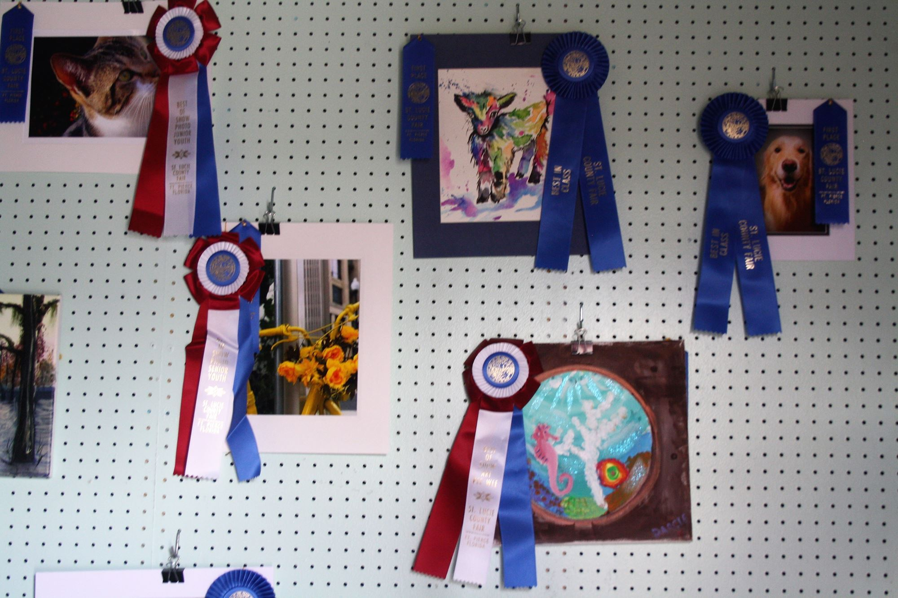
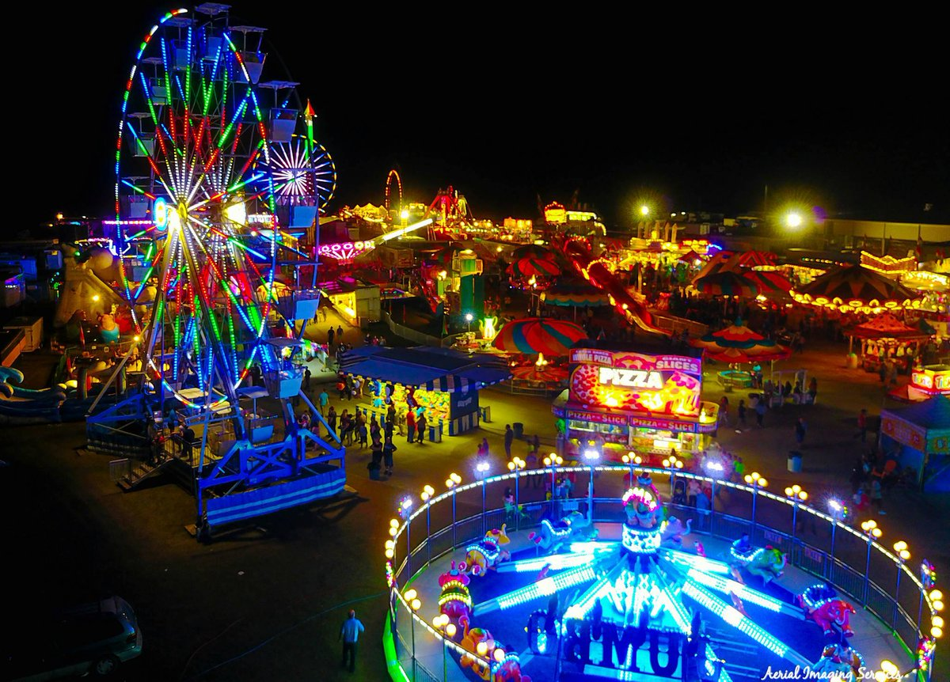
Calling all artists!
The St. Lucie County Fair is calling for artists of any age!
Limit 3 pieces per exhibitor for Art and/or Photography
No bigger 18” x 18”
Work must be matted
Art Mediums:
Pen & Ink
Mixed Medium
Watercolor
Oil
Acrylic
Pencil
Charcoal
Pastel
Crayon
Paper
Registration must be done online, but drop off is February 4th and 5th from 10am to 2pm in the Home Arts Building
If you would like Mrs. Perez to help you mat & register your work, please see her in 235 or email perez.lindsey@somersetcollegeprep.org
Photography Categories:
Landscape/Scenery
People/Portraits
Animals/insects/reptile
Flowers/plants/bushes
Black/white/sepia
Mixed (more than one category)
Enhanced (photo editing)

Slide 27
2023

Slide 28
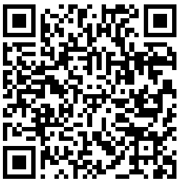
This year's Student Podcast Challenge will open for entries on Jan. 6, 2023 and close on April 28
https://www.npr.org/2022/12/14/1141665744/student-podcast-challenge-contest-npr-2023

Slide 29
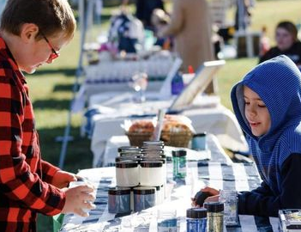
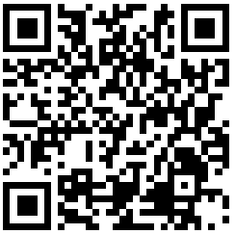
Observe the opportunity for children to launch their very own startup business!
Kids develop a brand, create a product or service, build a marketing strategy, and then open for customers at our one-day marketplace.
Outside the First Congregational Church, 36 booths will be at this first annual event on Saturday, February 11, 2023 from 10:00 a.m. – 12 p.m.
This event is sponsored by Acton Academy, the Acton School of Business, and the generous support of our donors and volunteers. We all believe that principled entrepreneurs are heroes and role models for the next generation.
https://www.childrensbusinessfair.org/portstlucie-acton

Slide 30
TURF DURING LUNCH
Volleyball
Monday-Friday: NO SPIKING!!!
Basketball
Monday/Wednesday: Middle school only
Tuesday/Thursday: Highschool only
Rotate Fridays

Slide 32
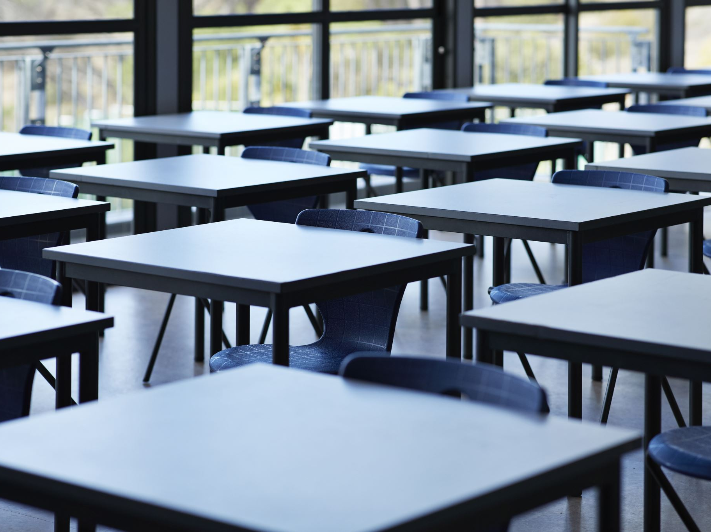
Clubs
Chorus Club for high school on Mondays, after school, in 268
D & D, Mondays, after school, in 175
Mock Trial in 263, on Mondays and Tuesdays during lunch.
Salsa Dancing in 136, on Tuesdays and Thursdays at lunch.
SGA, every other Wednesday, after school, from 3:45-5 in room 222
GSA on Wednesdays in 169 at lunch 11:55am-12:30pm
ASL on Wednesdays in the theater room, at 12pm on lunch.
Chorus Club for middle school on Thursdays, after school, in 268
Chess Club- Thursday at lunch, in 232
Senior Committee Meeting, Thursdays, after school, in 136

Slide 33
House Reminds
For anyone who needs the house remind this year ☺ This is important for communication with your house head.
Ares-@houseare
Athena-@scpaathena
Hestia- @househes
Poseidon- @psdnscpa
Zeus-@housezeus

Slide 34
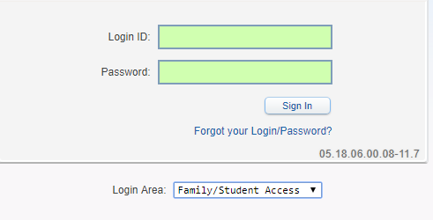
Student Skyward Access
Login ID: (Student 562#)
Password: (8 Digit Birthdate - MMDDYYYY)
Example: 08032005
**You May access Skyward through the school’s website.

